Slide 1

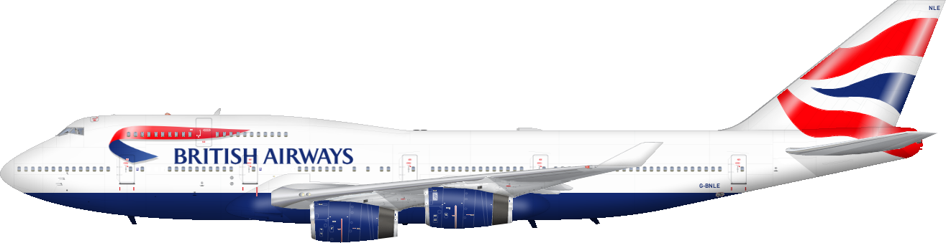

Raja Sekhar Rapaka

Slide 2
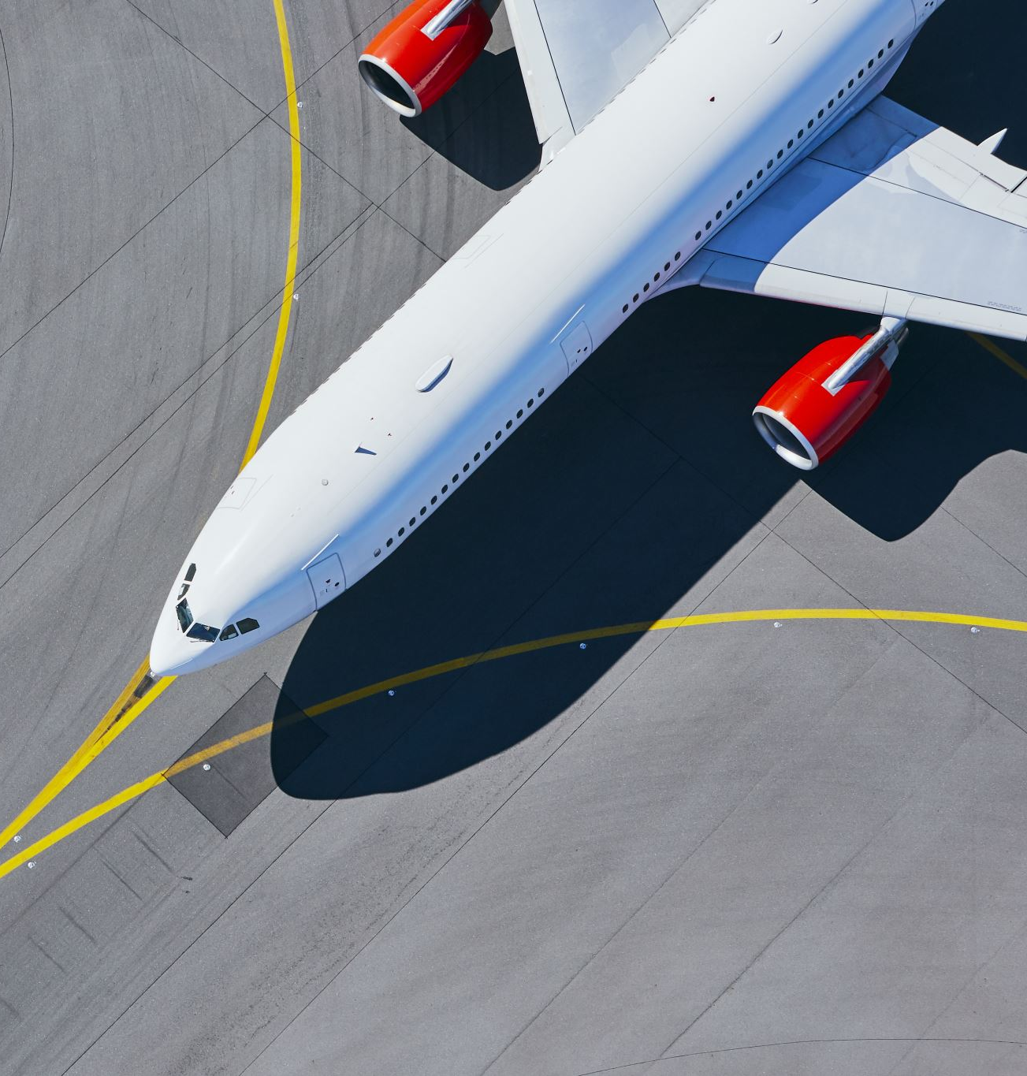
Introduction
British Airways (BA) is the flag carrier airline of the United Kingdom (UK). Every day, thousands of BA flights arrive to and depart from the UK, carrying customers across the world. Whether it’s for holidays, work or any other reason, the end-to-end process of scheduling, planning, boarding, fueling, transporting, landing, and continuously running flights on time, efficiently and with top-class customer service is a huge task with many highly important responsibilities.

Slide 3
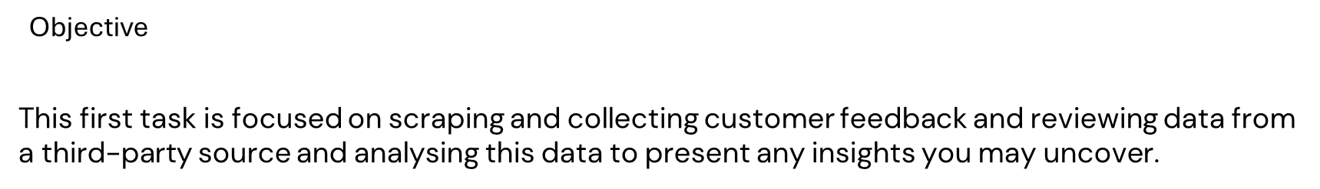
Problem Statement
As a data scientist at BA, it will be your job to apply your analytical skills to influence real life multi-million-pound decisions from day one, making a tangible impact on the business as your recommendations, tools and models drive key business decisions, reduce costs and increase revenue.
Customers who book a flight with BA will experience many interaction points with the BA brand. Understanding a customer's feelings, needs, and feedback is crucial for any business, including BA.

Slide 4

Procedure
Scrape data from the web
Analyze data
Present insights

Slide 5
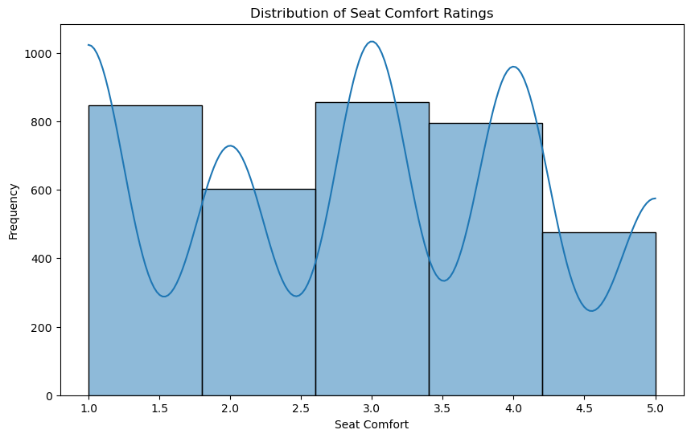
Most passengers find seats moderately comfortable with a slight skew towards higher comfort levels.

Slide 6
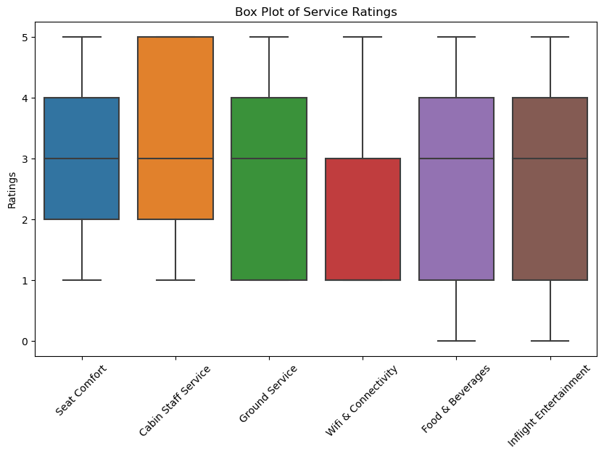
Cabin Staff Service received the highest ratings but also showed the greatest variation, Wifi & Connectivity had the lowest overall ratings and room for improvement.

Slide 7
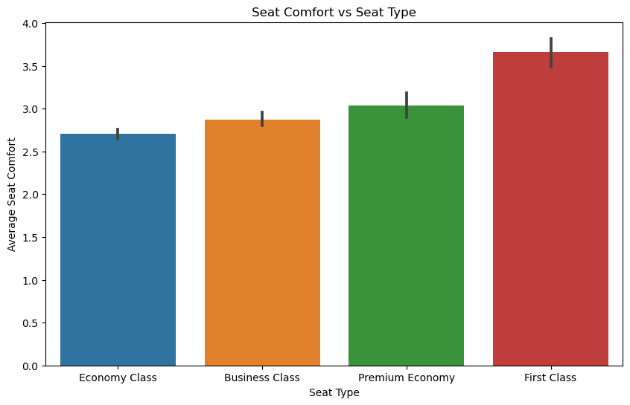
Seat comfort increases with seat class, with First Class having the highest average rating and Economy Class having the lowest. Error bars suggest variability in comfort ratings within each seat type.

Slide 8
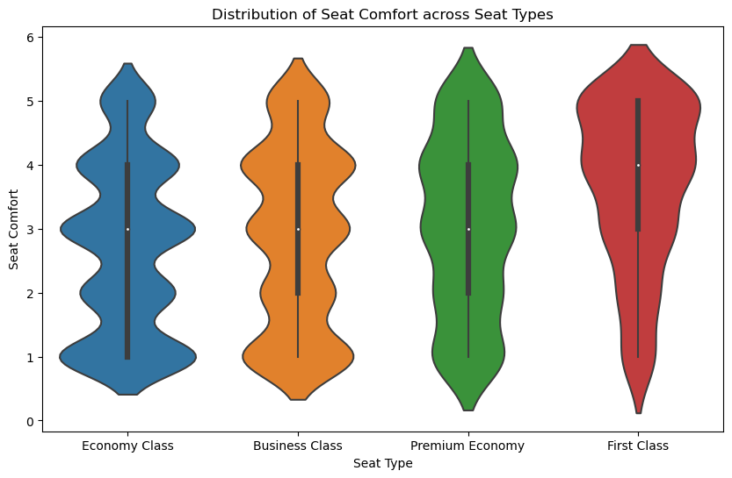
Seat comfort significantly increases from Economy Class to First Class, with wider distributions (more variability) in comfort ratings for lower seat classes.

Slide 9
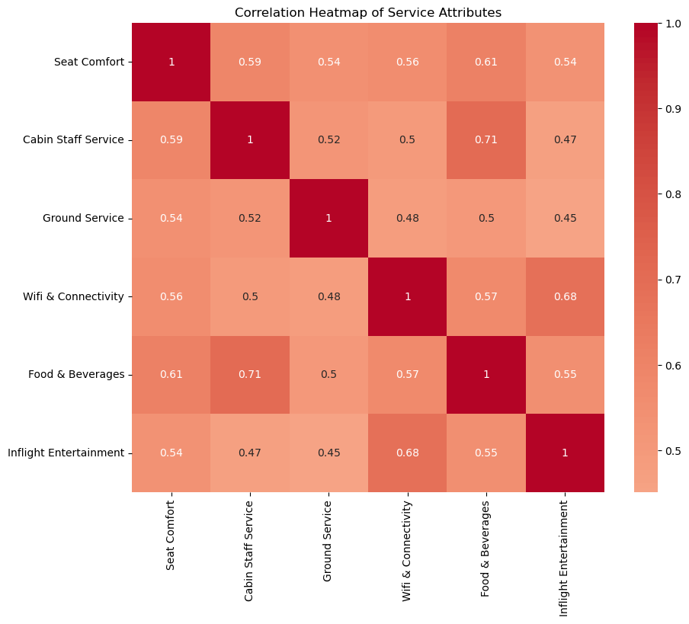
The correlation heatmap reveals strong positive relationships between most service attributes, with Cabin Staff Service and Food & Beverages demonstrating the highest correlations. Wifi & Connectivity has a notably lower correlation with other attributes.

Slide 10
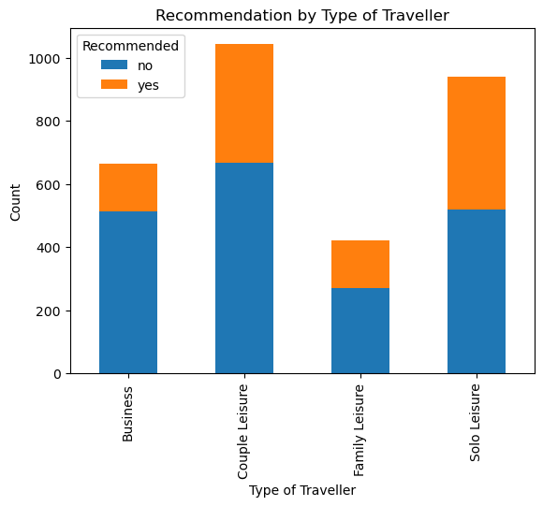
Couple and Solo Leisure travelers represent the largest segments, with Couples showing the highest rate of recommendations. However, Business travelers exhibit lower satisfaction levels, while Family Leisure travelers, despite being a smaller group, demonstrate a higher proportion of positive recommendations.

Slide 11
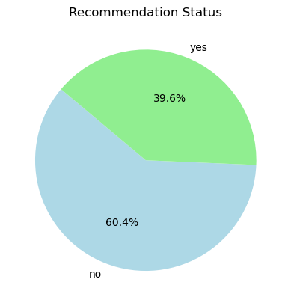
The pie chart shows the recommendation status, with 39.6% of respondents recommending and 60.4% not recommending. This indicates a higher proportion of respondents did not recommend the product or service.

Slide 12
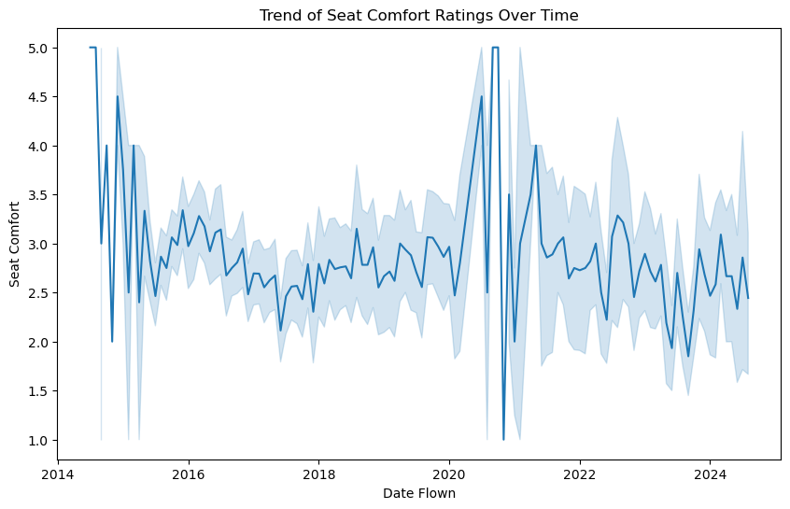
Seat comfort ratings exhibit significant fluctuations over time, with peaks and troughs occurring throughout the years. While there's a general upward trend, the year-to-year variability is substantial.

Slide 13
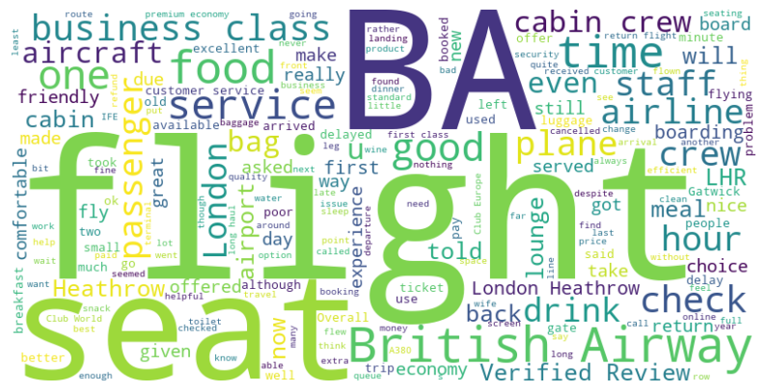
The word cloud highlights key aspects of British Airways' customer feedback, with frequent mentions of "flight," "seat," "service," and "business class," suggesting a focus on in-flight experience and comfort. Positive feedback centers around the crew and service, while operational concerns like "check," "boarding," and "delay" also appear prominently, especially at major hubs like Heathrow and Gatwick.

Slide 14
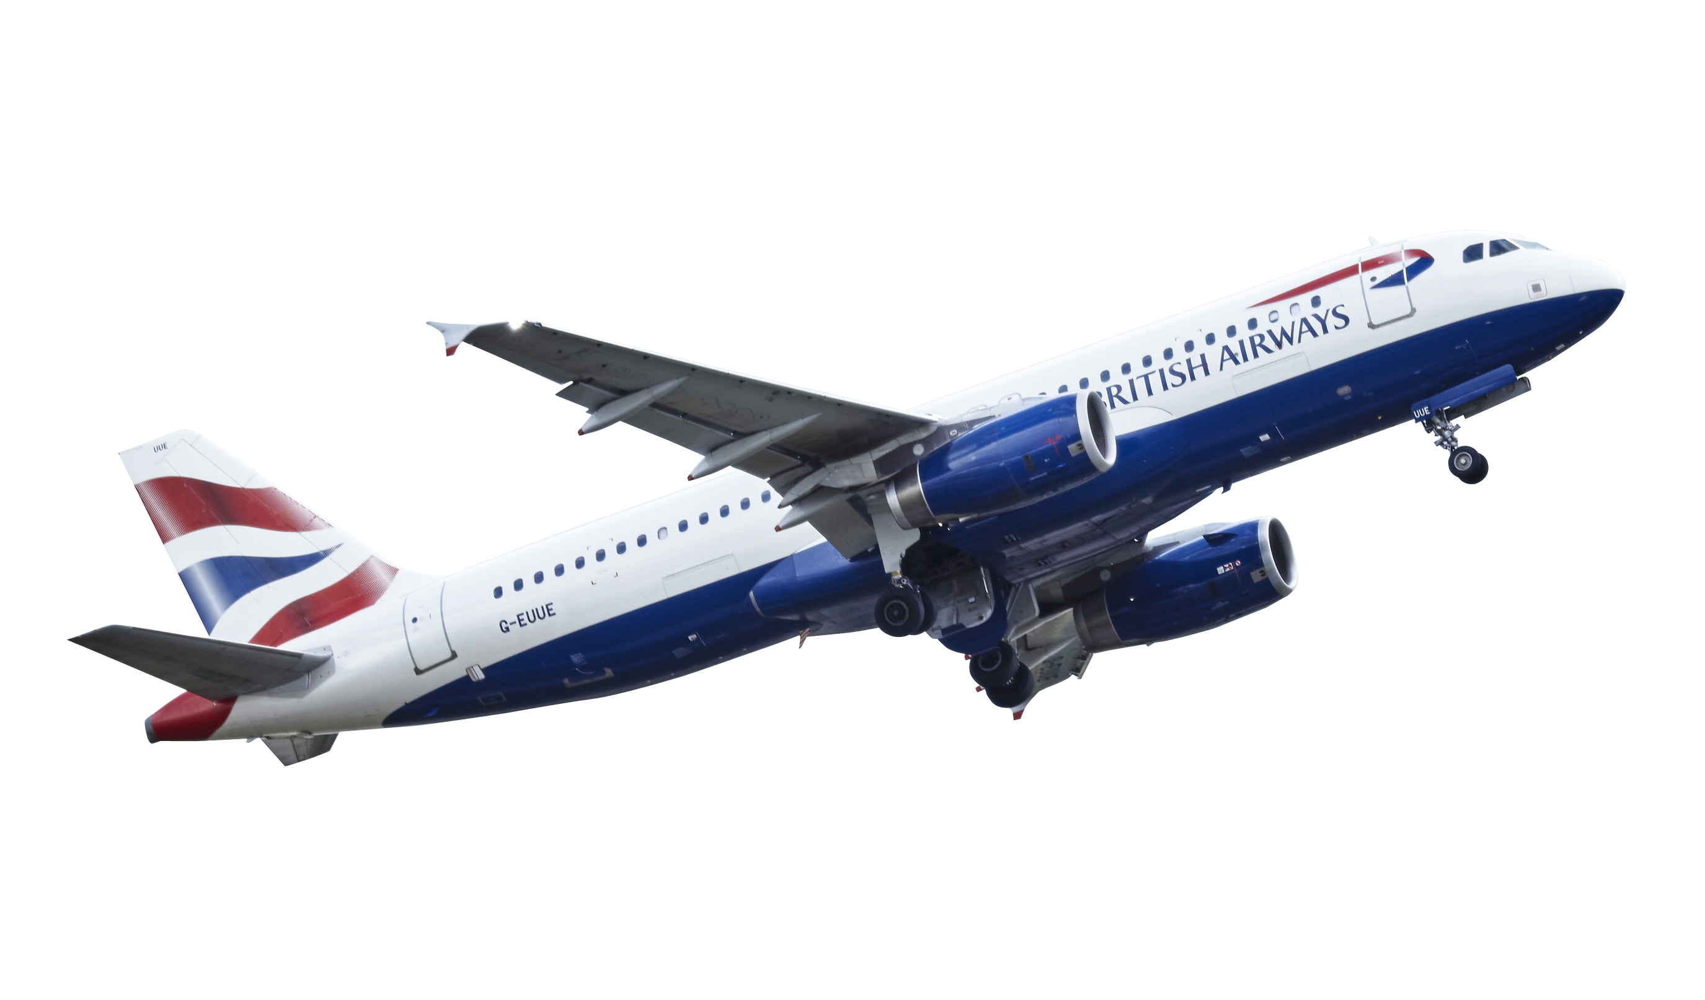
Thank You

